Slide 1
Assessment Of Mean Teacher And Prominent Adversarial Unlabeled Data For Language Classification
Master Thesis Presentation
On
Institute for Business and Management Informatics
University of Koblenz-Landau
Koblenz, March 2022
First Supervisor: Prof. Dr. Andreas Mauthe
Second Supervisor: Mr. Alexander Rosenbaum
Presented By:
Bhupender Kumar Saini
Notes:
Good afternoon,
My Name is Bhupender Kumar Saini and today I will be presenting my master thesis topic,

Slide 2
Agenda
Motivation
Basic details about Language models
Research Question
Proposed Methodology
Experiment Details
Data Augmentation
Dataset details
Hyperparameters
Experiment Result Analysis
Discussing Research Question
Conclusion, Limitation, and Future Works
References
Questions
Notes:
Agenda of todays presentation is
I will be giving brief motivtation behind the master thesis, basic details about language mdoels and research question.
Later, proposed methodology, experiment details and result will be presented .
Afterwards, I will give a brief explanation about research question
And will conclude this presenation with limitation and future works,

Slide 3
MOtivation
Master thesis topic
Comparatively less studied topic in NLP [2]
Language models are prone to adversarial attacks [3]
Lack of labelled data demands semi-supervised approach
Evaluating performance of semi-supervised fine tunning of Language model.
Introducing noise strategies
Utilizing language models
Scope of improvement in conventional fine-tuning
Mean teacher approach [5]
Demands focussed approach on adversarial training.
References
Christian Szegedy et al. “Intriguing Properties of Neural Networks”. (Feb. 2014).
Wenqi Wang et al. “Towards a Robust Deep Neural Network in Texts: A Survey”.
Di Jin et al. “Is BERT Really Robust? A Strong Baseline for Natural Language Attack on Text Classification and Entailment” , (Apr. 2020).
Nicolas Papernot et al. “Crafting Adversarial Input Sequences for Recurrent Neural Networks”. In: arXiv:1604.08275 [cs] (Apr. 2016). arXiv: 1604.08275 [cs].
Antti Tarvainen and Harri Valpola. “Mean Teachers Are Better Role Models: Weight- averaged Consistency Targets Improve Semi-Supervised Deep Learning Results”.
Notes:
In 2014, Christian Szegedy and their team showed that by adding an imperceptibly small, but carefully designed perturbation can successfully lead the machine learning model to make a wrong prediction called adversarial attacks.
Later various studies in different domain also confirmed this vulneratbilities.
In 2016, Papernot confirmed the same in Natural language processing in Recurrent Neural networks.
Later various studies were presented to different strategies to craft adversarial sample, unfortunately study direction was least concentrated on robustness enhancement and verifications.
Adversarial attacks are more studied topic in computer visualization domain [2] than NLP.
Despite state-of-art performance, language model perform badly under adversarial attacks.
BERT’s accuracy drops drastically under Adversarial Attacks [3].
Questions the conventional way of fine-tuninng.
In 2014, Christian Szegedy and their team showed that by adding an imperceptibly small, but carefully designed perturbation can successfully lead the machine learning model to make a wrong prediction called adversarial attacks.
Later various studies in different domain also confirmed this vulnerabilities.
>
In 2016, Papernot confirmed the same in Natural language processing in Recurrent Neural networks.
Later various studies were presented to different strategies to craft adversarial sample, unfortunately study direction was least concentrated on robustness enhancement and verifications.
Devlin and his team first presented BERT which outperformed in various task.
In 2020, Jin showed that BERT model is not robust. Their performance degrades drastically.
Raises concern of trust, safety, and security on langauge model.

Slide 4
Research Question
Implementing Semi-supervised Mean Teacher approach.
Utilizing attack recipes
Robustness evaluation
Creating prominent adversarial unlabelled data.
Introducing crafted adversarial unlabelled data into training.
Is the proposed mean teacher semi-supervised fine-tuning and the use of prominent adversarial unlabelled data an effective method to improve the robustness of language models, specifically concerning accuracy under attack without compromising the original accuracy in contrast to the conventional fine-tuning approach?
BERT [1] and DistillBERT [2] model
Fine-tuned using conventional approach.
MTBERT and MTDistillBERT model
Fine-tuned using mean teacher semi-supervised approach.
Notes:
Is mean teacher semi-supervised approach effects the robustness of language model?
Can prominent unlabelled data created by langauge models enhance the model performance ?

Slide 5
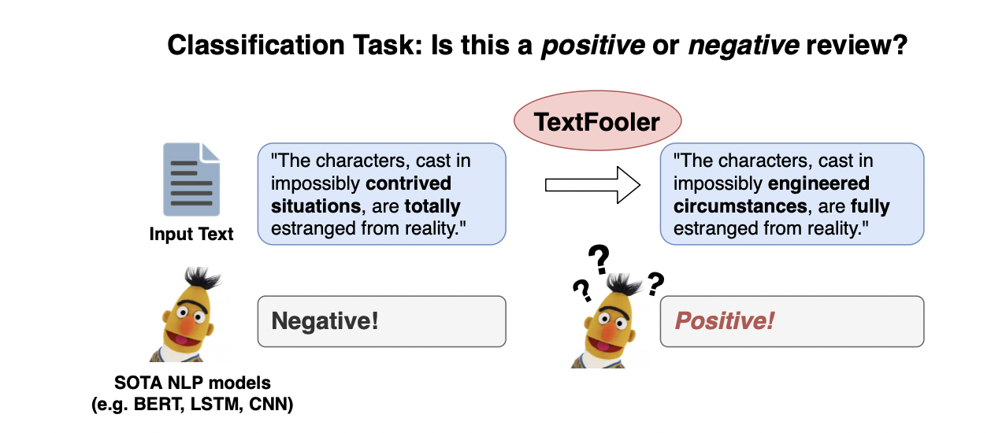
MOtivation
Adversarial attacks are more studied topic in computer visualization domain [2] than NLP.
Despite state-of-art performance, language model perform badly under adversarial attacks.
BERT’s accuracy drops drastically under Adversarial Attacks [3].
Questions the conventional way of fine-tuninng.
An text attack example presented by Jin et al. [3]
References
Christian Szegedy et al. “Intriguing Properties of Neural Networks”. (Feb. 2014).
Wenqi Wang et al. “Towards a Robust Deep Neural Network in Texts: A Survey”.
Di Jin et al. “Is BERT Really Robust? A Strong Baseline for Natural Language Attack on Text Classification and Entailment” , (Apr. 2020).
Nicolas Papernot et al. “Crafting Adversarial Input Sequences for Recurrent Neural Networks”. In: arXiv:1604.08275 [cs] (Apr. 2016). arXiv: 1604.08275 [cs].
Notes:
In 2014, Christian Szegedy and their team showed that by adding an imperceptibly small, but carefully designed perturbation can successfully lead the machine learning model to make a wrong prediction called adversarial attacks.
Later various studies in different domain also confirmed this vulneratbilities.
>
In 2016, Papernot confirmed the same in Natural language processing in Recurrent Neural networks.
Later various studies were presented to different strategies to craft adversarial sample, unfortunately study direction was least concentrated on robustness enhancement and verifications.
Devlin and his team first presented BERT which outperformed in various task.
In 2020, Jin showed that BERT model is not robust. Their performance degrades drastically.
Raises concern of trust, safety, and security on langauge model.

Slide 6
Cont..
Implementing Semi-supervised Mean Teacher approach in text classification.
Utilizing attack recipes
Robustness evaluation
Utilizing Language model to create prominent adversarial unlabelled data.
Introducing crafted adversarial unlabelled data into training,
Unlabelled data could be created using langauge models paraphrasing capabilities.
In computer visualization, Mean teacher approach claimed to provide robust model [1].
Is mean teacher semi-supervised approach effects the robustness of language model?
Can prominent unlabelled data created by langauge models enhance the model performance ?
References
Antti Tarvainen and Harri Valpola. “Mean Teachers Are Better Role Models: Weight- averaged Consistency Targets Improve Semi-Supervised Deep Learning Results”.
Notes:
Is mean teacher semi-supervised approach effects the robustness of language model?
Can prominent unlabelled data created by langauge models enhance the model performance ?

Slide 7
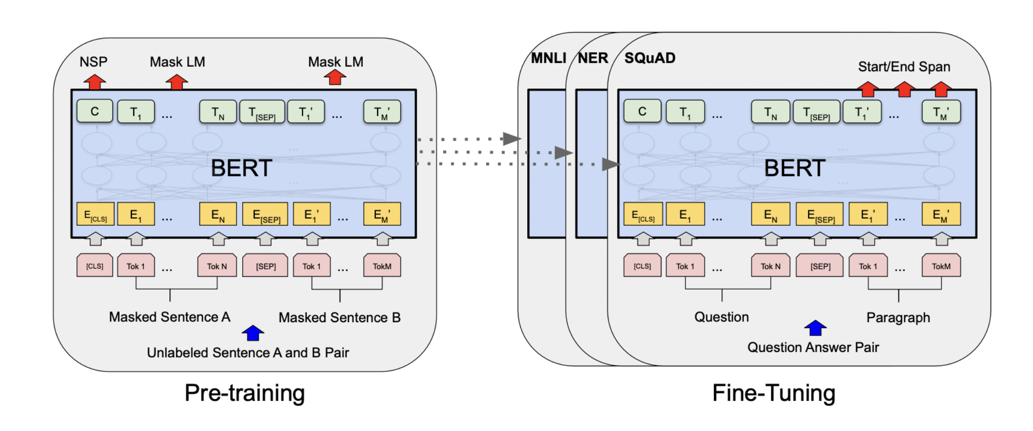
Language Model
Language model learns word representation from huge corpus and provides vector for further tasks.
BERT variets are based on transformer architechture, attention mechanism, and facilitate parallel computations.
Pre-training and fine-tuning method of the BERT model [1]. In pre-training, unsupervised techniques such as next sentence prediction (NSP) and masked word prediction (MWP) are utilized. Pre-trained models are provided to perform further downstream tasks and weights are further optimized during fine-tuning.
References
Jacob Devlin et al. “BERT: Pre-training of Deep Bidirectional Transformers for Language Understanding”. In: arXiv:1810.04805 [cs] (May 2019). arXiv: 1810.04805 [cs].
Victor Sanh et al. “DistilBERT, a Distilled Version of BERT: Smaller, Faster, Cheaper and Lighter”. In: arXiv:1910.01108 [cs] (Feb. 2020). arXiv: 1910.01108 [cs].

Slide 8
Research question
Is the proposed mean teacher semi-supervised fine-tuning and the use of prominent adversarial unlabelled data an effective method to improve the robustness of language models, specifically concerning accuracy under attack without compromising the original accuracy in contrast to the conventional fine-tuning approach?
BERT [1] and DistillBERT [2] model
Fine-tuned using conventional approach.
MTBERT and MTDistillBERT model
Fine-tuned using mean teacher semi-supervised approach
References
Jacob Devlin et al. “BERT: Pre-training of Deep Bidirectional Transformers for Language Understanding”. In: arXiv:1810.04805 [cs] (May 2019). arXiv: 1810.04805 [cs].
Victor Sanh et al. “DistilBERT, a Distilled Version of BERT: Smaller, Faster, Cheaper and Lighter”. In: arXiv:1910.01108 [cs] (Feb. 2020). arXiv: 1910.01108 [cs].

Slide 9
Proposed methodology

Slide 10
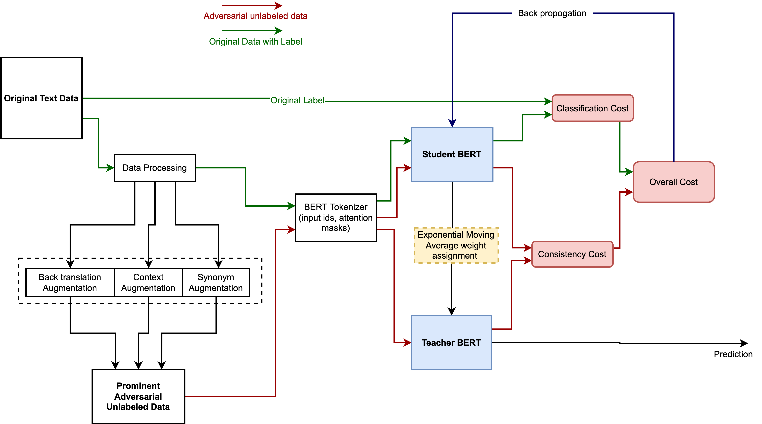
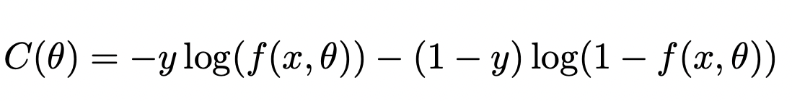
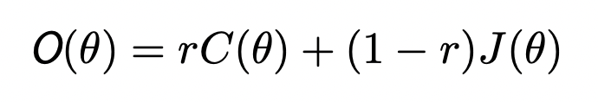
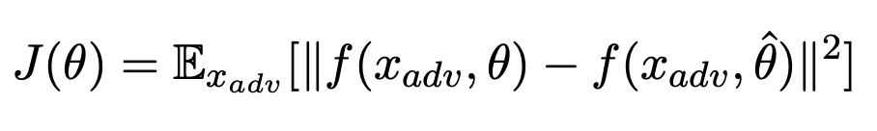
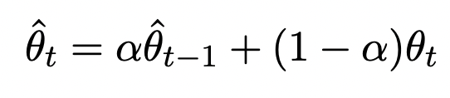
Proposed mean teacher fine-tuning of language model

Slide 11
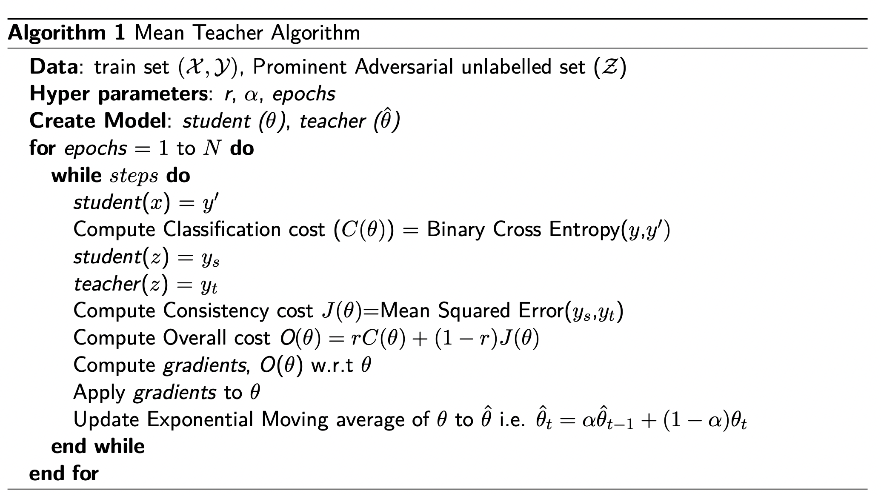
algorithm
Notes:
Not required

Slide 12
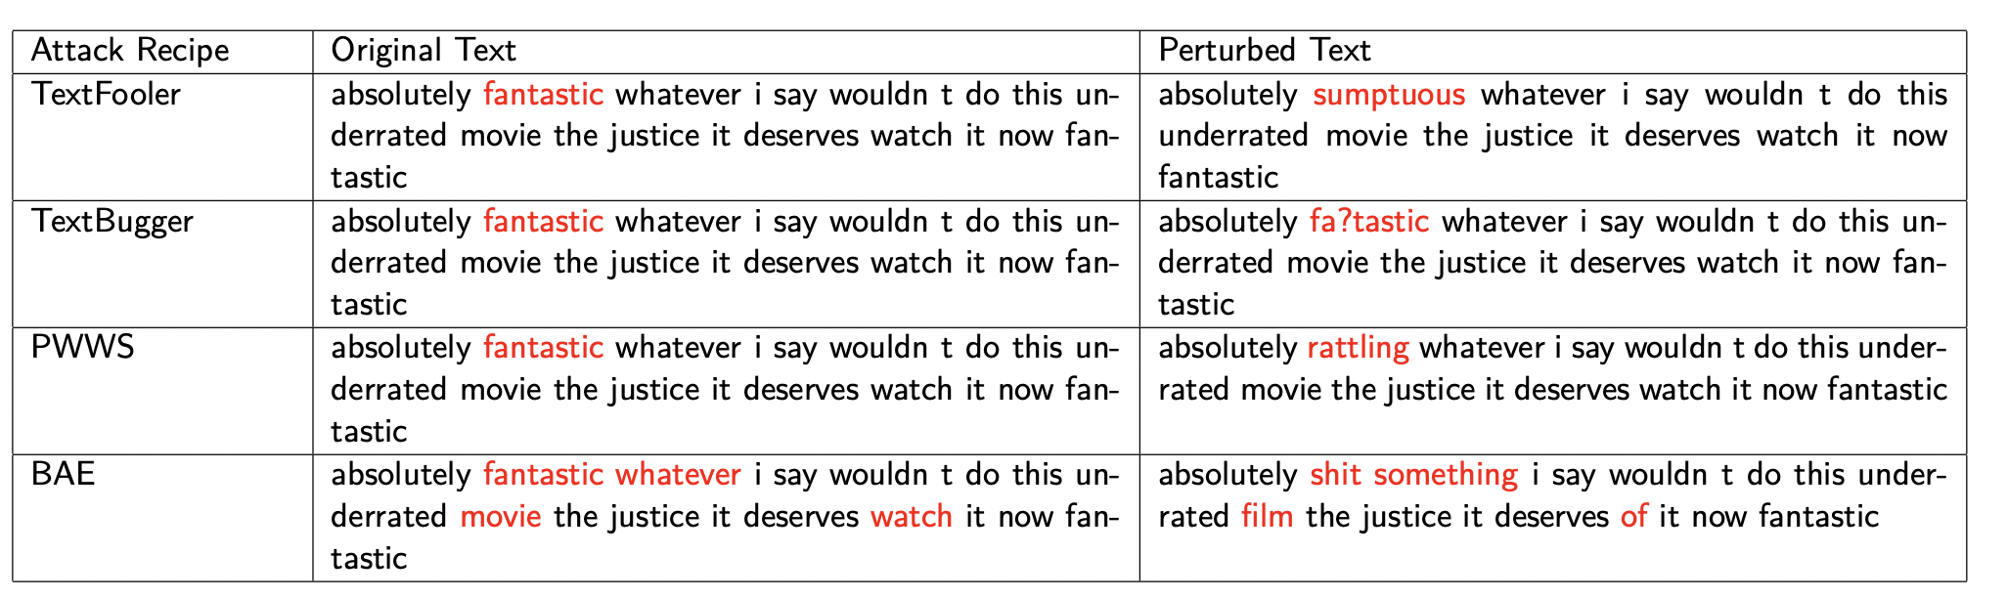
Attack Recipes Used for Evaluation
TextFoolerJin2019 [1].
TextBugger [2].
PWWSRen 2019 [3].
BAEGarg2019 [4].
Common Strategy
Identifying important words.
Replacement strategies.
Perturbation examples of attack recipes in this experiment.
Textattack [5] python library
References
Di Jin et al. “Is BERT Really Robust? A Strong Baseline for Natural Language Attack on Text Classification and Entailment”.
Jinfeng Li et al. “TextBugger: Generating Adversarial Text Against Real-world Applications”.
Shuhuai Ren et al. “Generating Natural Language Adversarial Examples through Probability Weighted Word Saliency”.
Siddhant Garg and Goutham Ramakrishnan. “BAE: BERT-based Adversarial Examples for Text Classification”.
John X. Morris et al. “TextAttack: A Framework for Adversarial Attacks, Data Augmentation, and Adversarial Training in NLP”.

Slide 13
Experiment details

Slide 14
Dataset
Dataset | Total (Fake/Real) | Attack dataset (Fake/Real) | Avg. Length | Aug. unlabled dataset
Codalab¹ ^{Covid-19 Fake tweet} | 6090 (3199/2891) | 2000 (1071/969) | 25 | 6090
IMDB² ^{Sentiment} | 6050 (3025/3025) | 2000 (1000/1000) | 127 | 6050
texthero³ python library
is utilized for pre-processing
Dataset details for the experiment.
Data Preprocessing
HTML tags removal.
Digit removal.
Lower casing.
Punctuation removal.
IMDB dataset has comparatively higher number of correct words, and larger text length too.
Fake tweet dataset is collection of tweets so have incorrect spellings(hashtags), lower vocabulary size, and text length.
Reference
Parth Patwa et al. “Fighting an Infodemic: COVID-19 Fake News Dataset”. In: arXiv:2011.03327 [cs] (Mar. 2021). arXiv: 2011.03327 [cs]
Andrew L. Maas et al. “Learning Word Vectors for Sentiment Analysis”. In: Proceedings of he 49th Annual Meeting of the Association for Computational Linguistics: Human Language Technologies.
https://texthero.org/

Slide 15
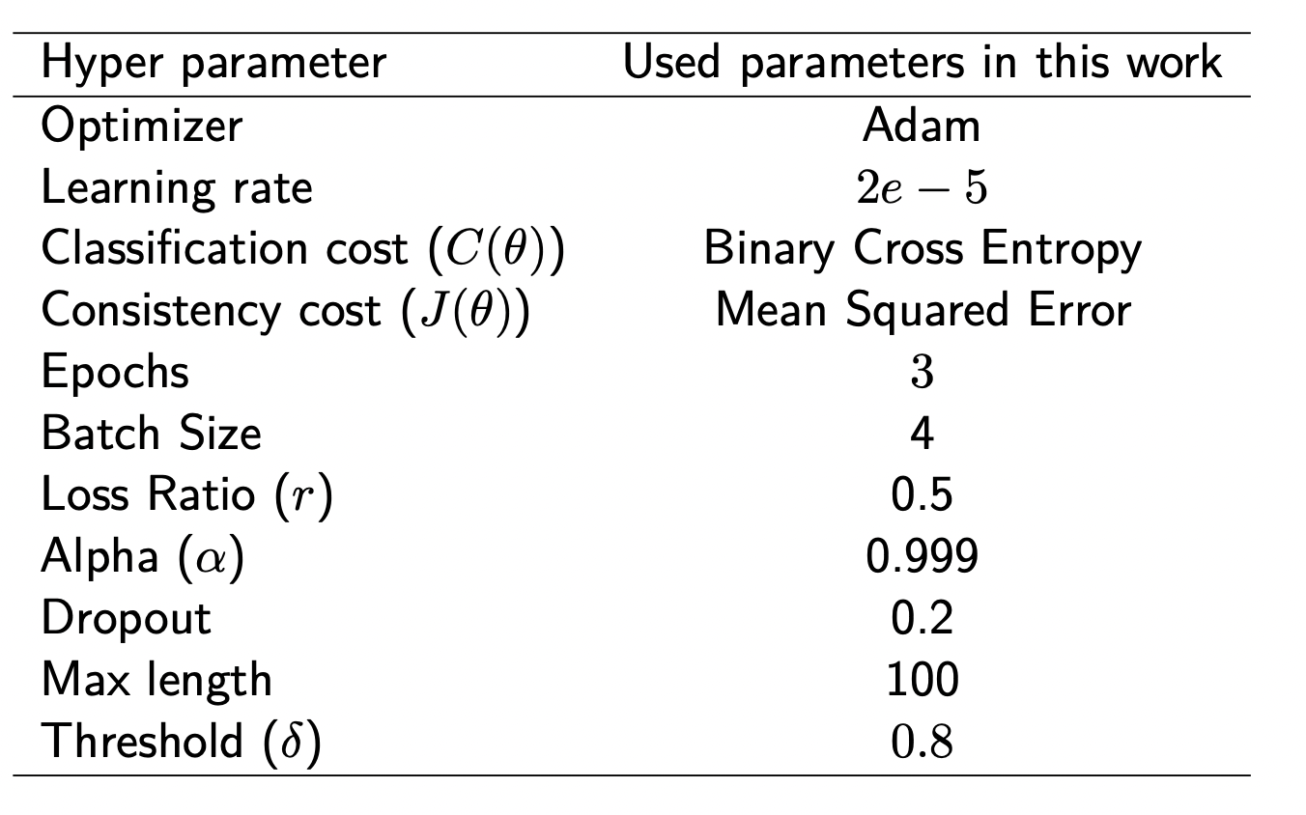
Hyperparameter
Hyperparamter details

Slide 16
Evaluation Metrics
Original Accuracy(%) : Total correct predictions given the number of test samples.
Accuracy Under Attack(%) : Accuracy shown by model under attack. (More is good, less is bad : For model)
Attack Success Rate(%): Accuracy of attack recipes in attacking the models. (No. of successful attack/ attack attempts)
Average Perturbation(%): Average number of words needs to change in the test samples. (Lower is better, Higher is bad : For model)
Average Number of queries : Average number of queries while attacking the test samples.(Higher is better, and lower is bad : For model).
Perturbation Score: Prediction Probability of successful attack. (Lower confidence score in case of successful attack is good for model)
Research Question:
MT BERT and MT DistilBERT should have:
Higher Original Accuracy than baseline model.
Higher Accuracy under Attack than baseline models.
Lower Success Rate than baseline model.
Higher Perturbation rate than baseline models.
Higher Average Number of queries required to get attacked than baseline models.
Lower range of perturbation score of successful attacks.

Slide 17
Data Augmentation
Synonym based
WordNet lexical English database [1] is used as a source of synonym augmentation.
For IMDB and Covid-19 fake tweets datasets, it is augment threshold set to 50 and 15, respectively.
Context based
DistilBERT langauge model is utilized.
Back translation
Marian language model is used.
References
George A. Miller. “WordNet: A Lexical Database for English”. In: Communications of the ACM 38.11 (Nov. 1995), pp. 39–41. issn: 0001-0782. doi: 10.1145/219717.219748.

Slide 18
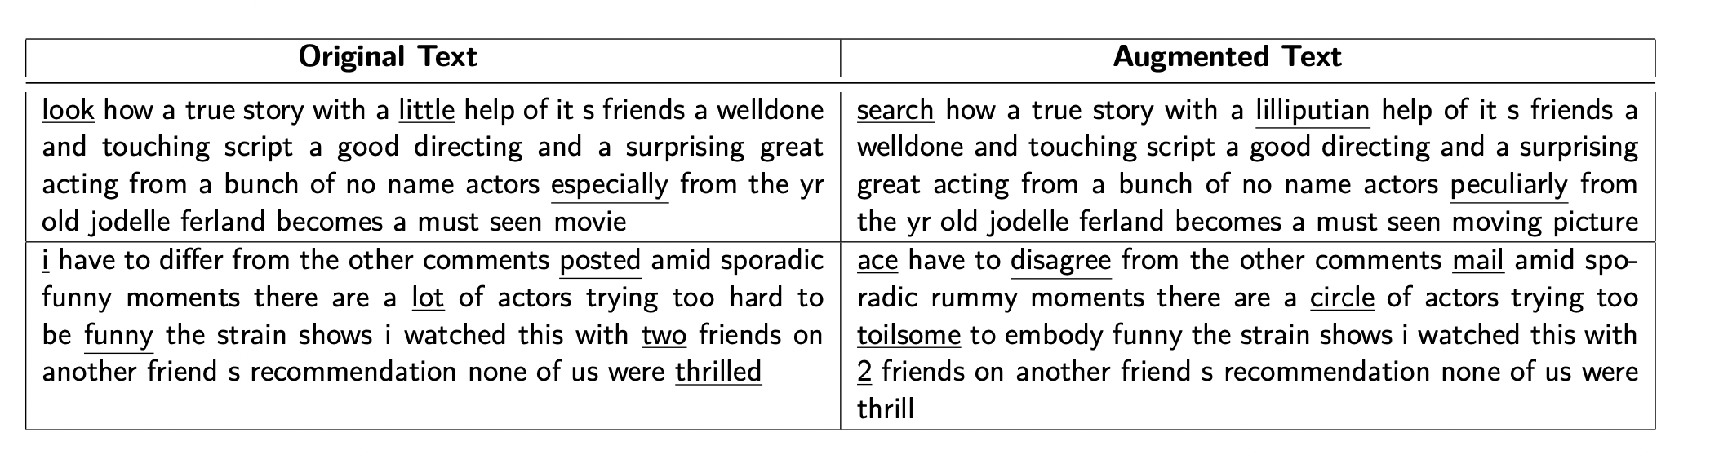
Data Augmentation
Synonym based
WordNet lexical English database [1] is used as a source of synonym augmentation.
For IMDB and Covid-19 fake tweets datasets, it is set to 50 and 15, respectively.
Sample example of synonym based augmentation from IMDB dataset.
References
George A. Miller. “WordNet: A Lexical Database for English”. In: Communications of the ACM 38.11 (Nov. 1995), pp. 39–41. issn: 0001-0782. doi: 10.1145/219717.219748.

Slide 19
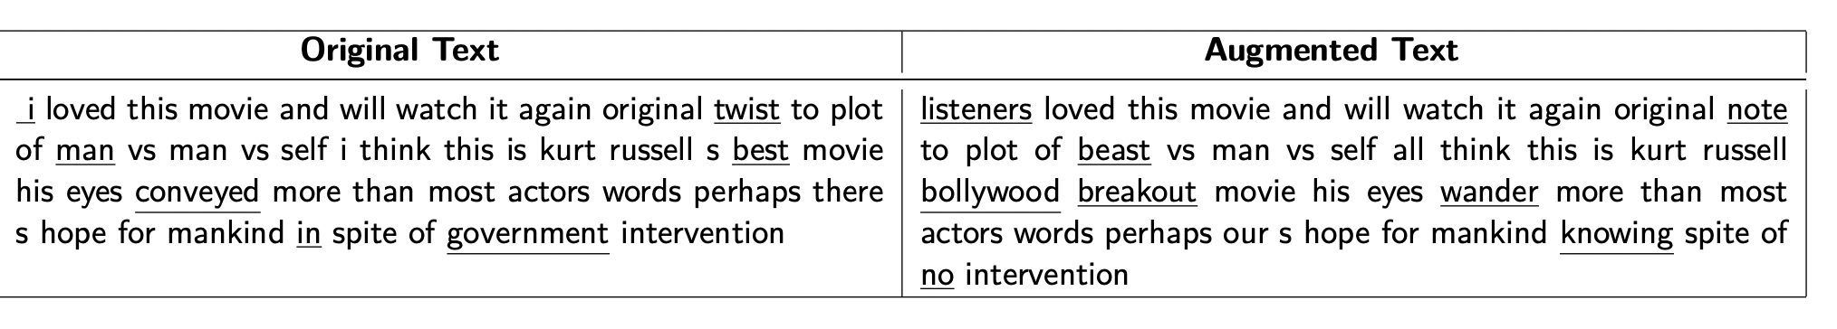
Data Augmentation
Context based
DistilBERT langauge model is utilized.
NLPaug1 python package is utilized.
Sample example of context-based augmentation from IMDB dataset.
References
Edward Ma. Nlpaug. https://github.com/makcedward/nlpaug. Jan. 2022.

Slide 20
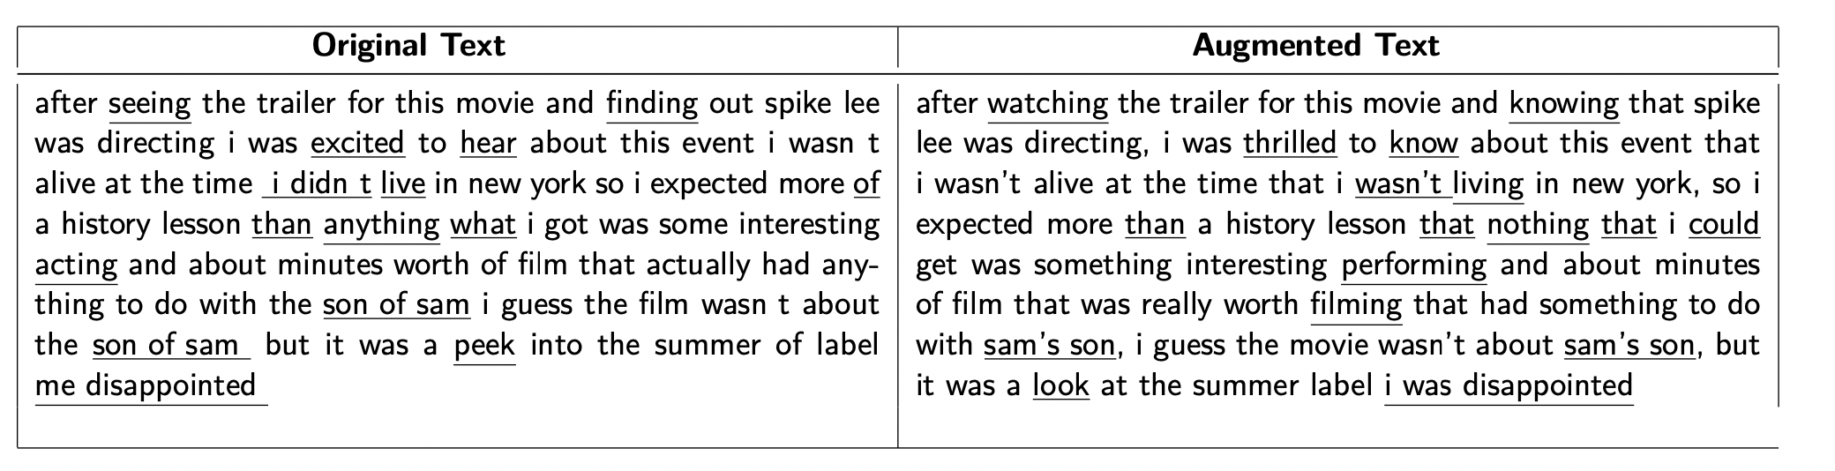
Data Augmentation
Back Translation
Marian Translation framework is used.
English → Romance Language → English.
Nlpaug1 python package is utilized
Sample example of back translation based augmentation from IMDB dataset.
References
Edward Ma. Nlpaug. https://github.com/makcedward/nlpaug. Jan. 2022.

Slide 21
Experiment Result analysis

Slide 22
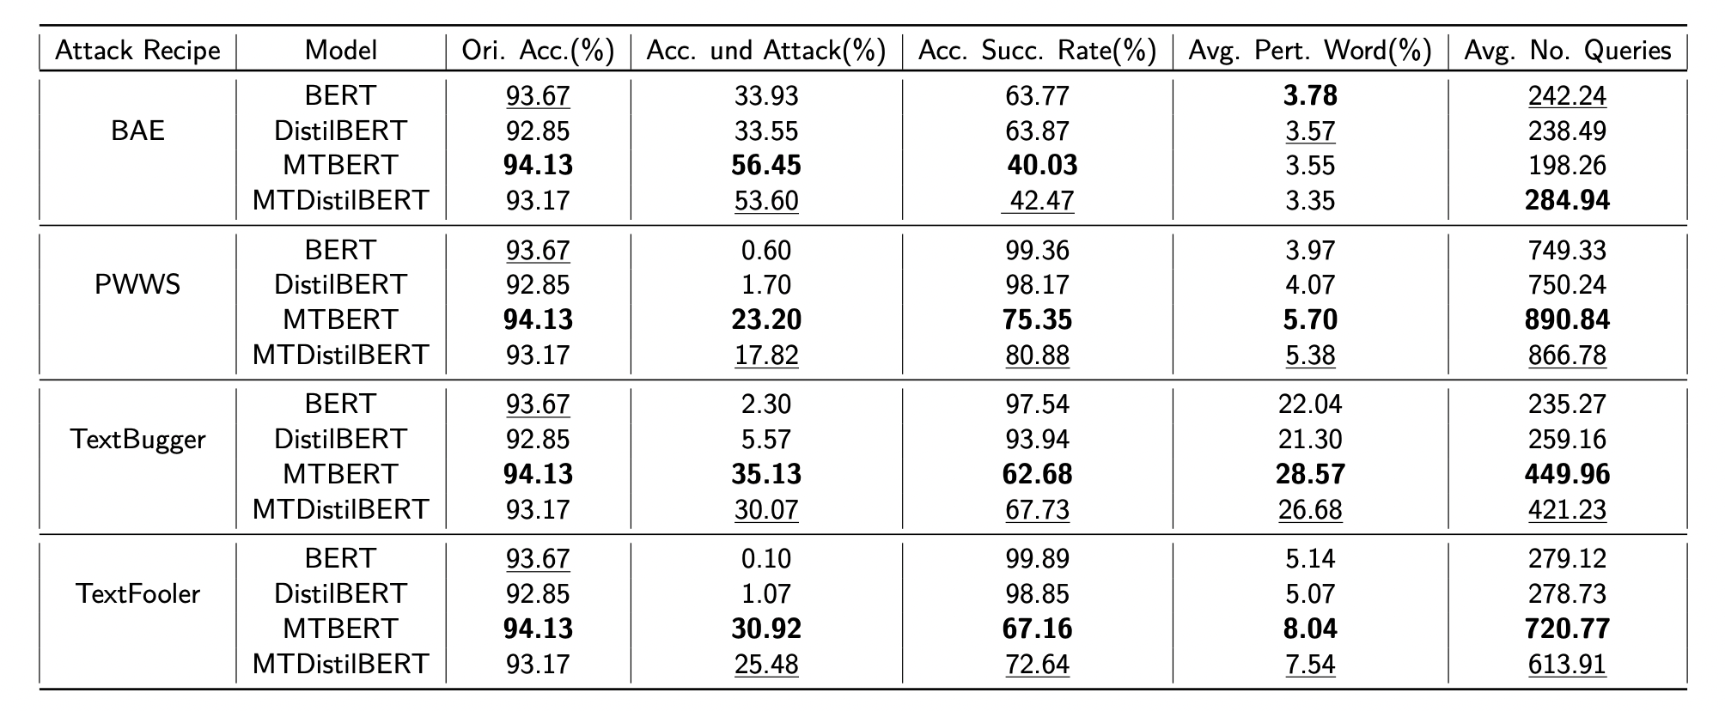
Experiment results - IMDB Dataset
Overall, MT BERT has shown better original accuracy and Accuracy under attack.
Except Average perturbation in BAE attack recipe, MTBERT has outperformed all mentioned model.
Followed by MTDistilBERT
IMDB dataset: MTBERT performed best in the experiment, followed by MTDistilBERT. Bold and underlined values represent first and second best values.

Slide 23
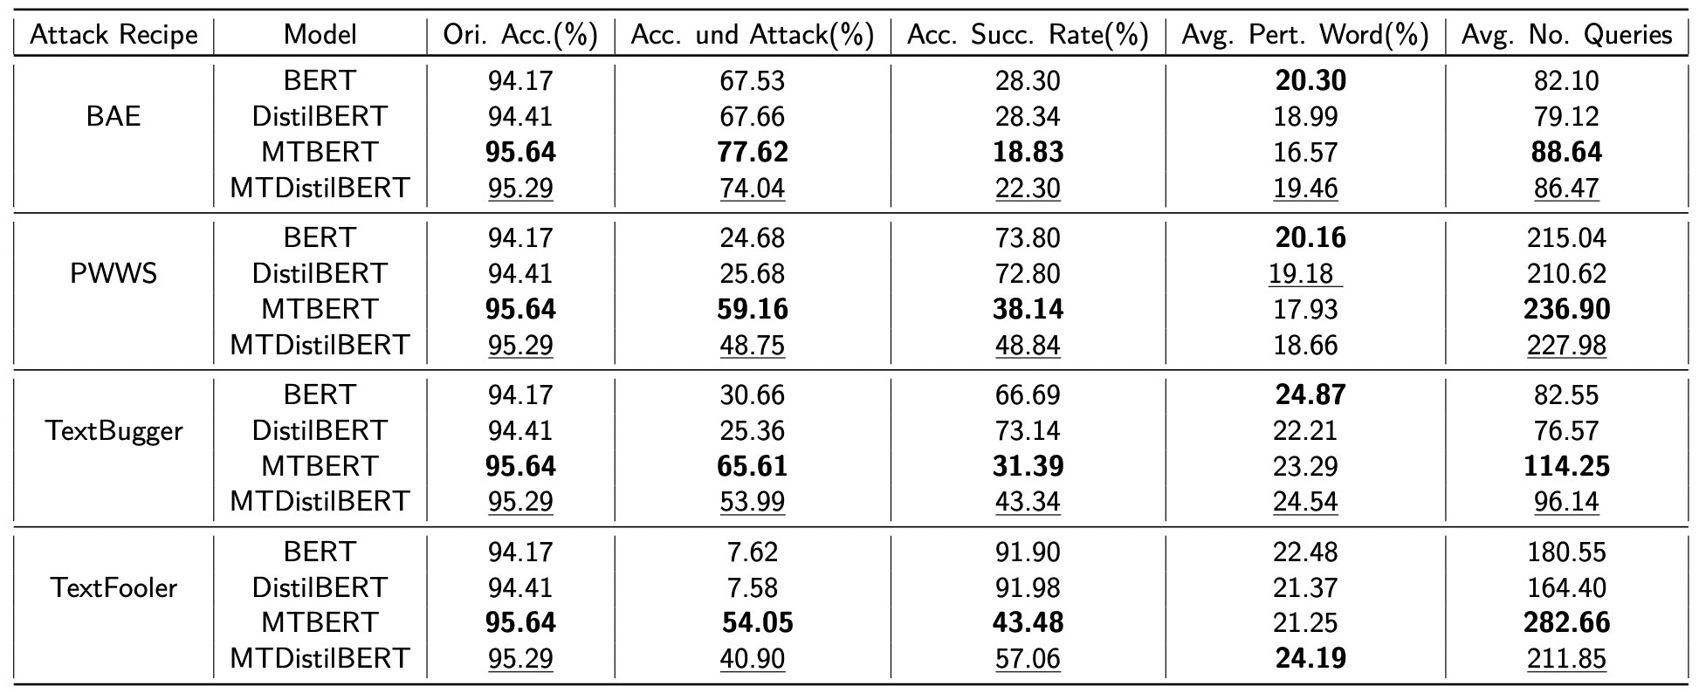
Experiment results- Covid-19 fake tweets dataset
Except Average perturbation in BAE attack recipe, MTBERT has outperformed all mentioned model.
Followed by MTDistilBERT
Covid-19 fake tweets dataset: MTBERT model has performed well overall, followed by MTDistilBERT. Bold and underlined values represent first and second best values.

Slide 24
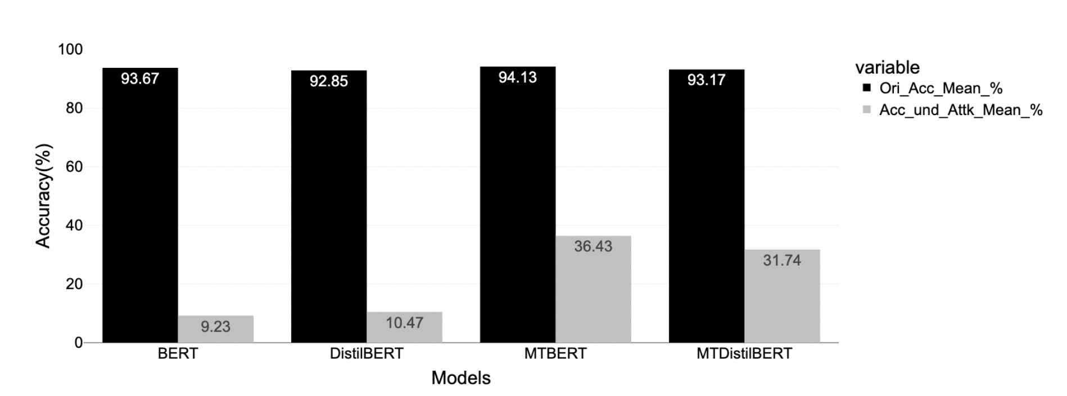
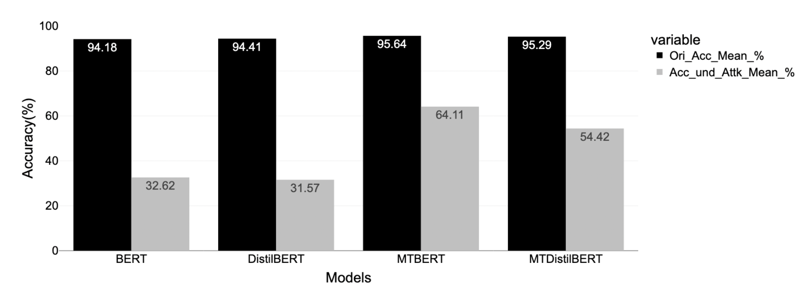
Accuracy
Model fine-tuned using proposed approach (MTBERT and MTDistilBERT) shown better original accuracy and accuracy under attack.
MTBERT has shown better original accuracy(0~2% better) followed by MTDistilBERT.
MTBERT has shown 20∼30% improvement in accuracy under attack compared to BERT considering both dataset.
IMDB Dataset: Mean Original Accuracy and Accuracy under attack considering four attack recipes.
Covid-19 fake tweet: Mean Original Accuracy and Accuracy under attack considering four attack recipes.

Slide 25
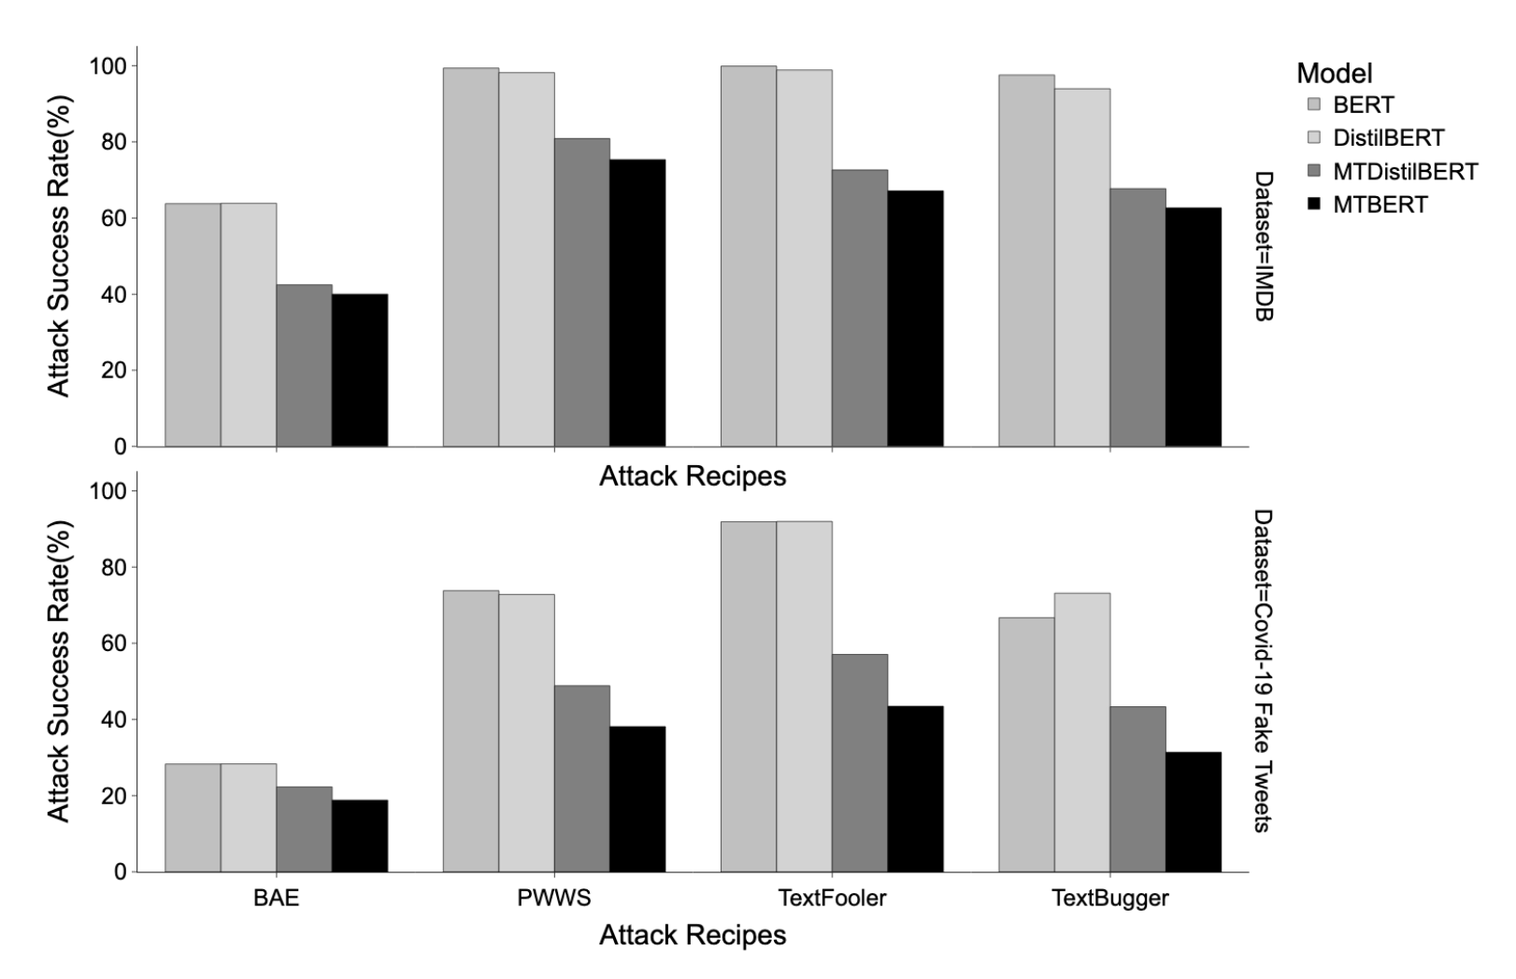
Attack success rate
The TextFooler attack recipe observed to be most effective at attacking the language models followed by PWWS.
On the other hand, BAE has been least effective, followed by TextBugger.
language models fine-tuned using the proposed approach show the lowest attack success rate.
Bar plot of attack success rate

Slide 26
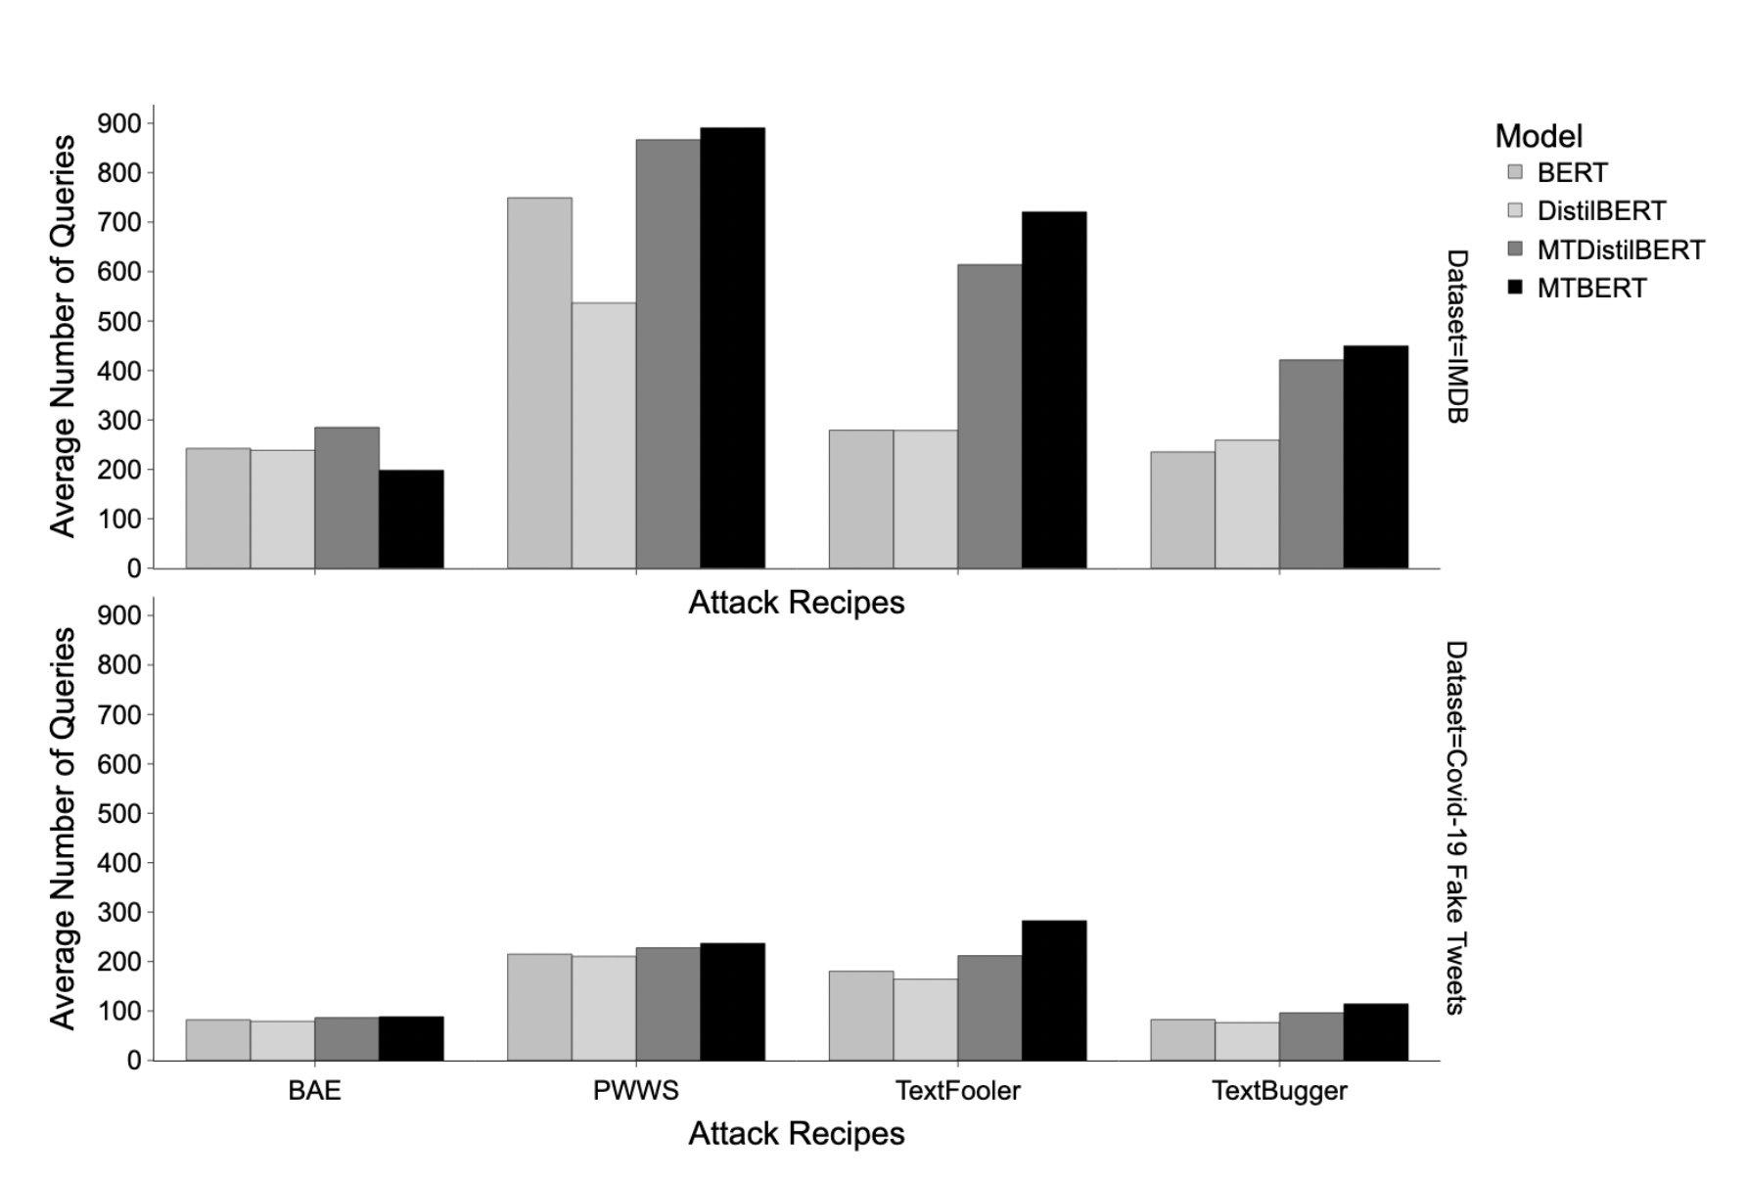
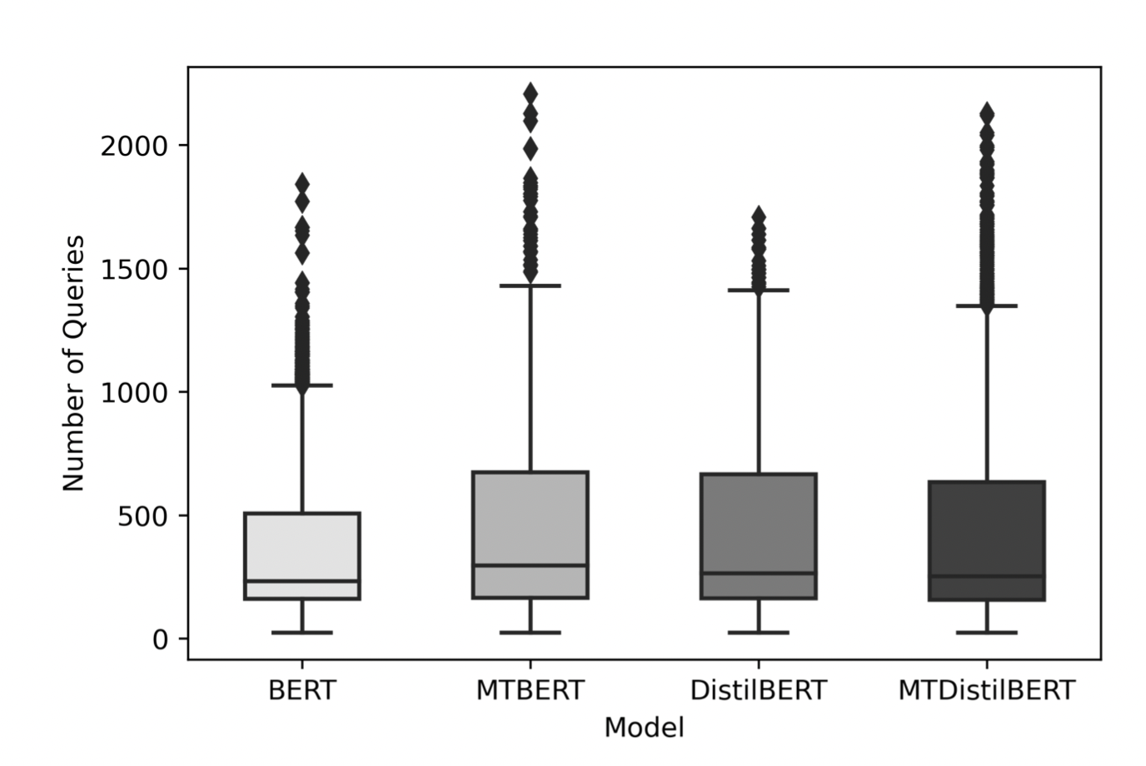
Number of Queries
Box plot of the number of queries.
Bar plot of the number of queries.
The proposed approach models are comparatively broader and showed greater values for outliers than baseline models.
This particular box plot is based on the IMDB dataset and only successful attacks are considered.
MTBERT model require higher queries for attacking except BAE attack Recipes.
PWWS require high queries to attack followed by TextFooler.
Notes:
TextFooler and PWWS has shown significant difference in both dataset.
TextFooler: the difference in between MT BERT and BERT number of queries is higher or doubled in case of IMDB dataset.

Slide 27
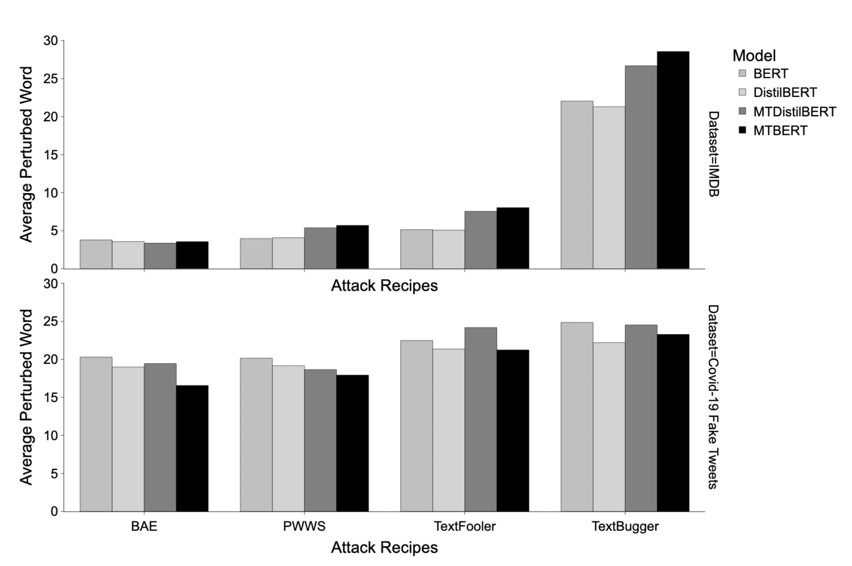
Word perturbation
In IMDB dataset, MTBERT model has shown highest perturbation requirement followed by MT DistilBERT.
In case of Fake tweets Dataset, BERT model has shown highest perturbation followed by MT DistilBERT.
The difference of perturbation in between dataset is higher.
IMDB dataset has lower words perturbation in contrast of Fake news dataset.
TextBugger require higher number of perturbation of words followed by TextFooler.
Bar plot of word perturbation as per datasets and attack recipes.

Slide 28
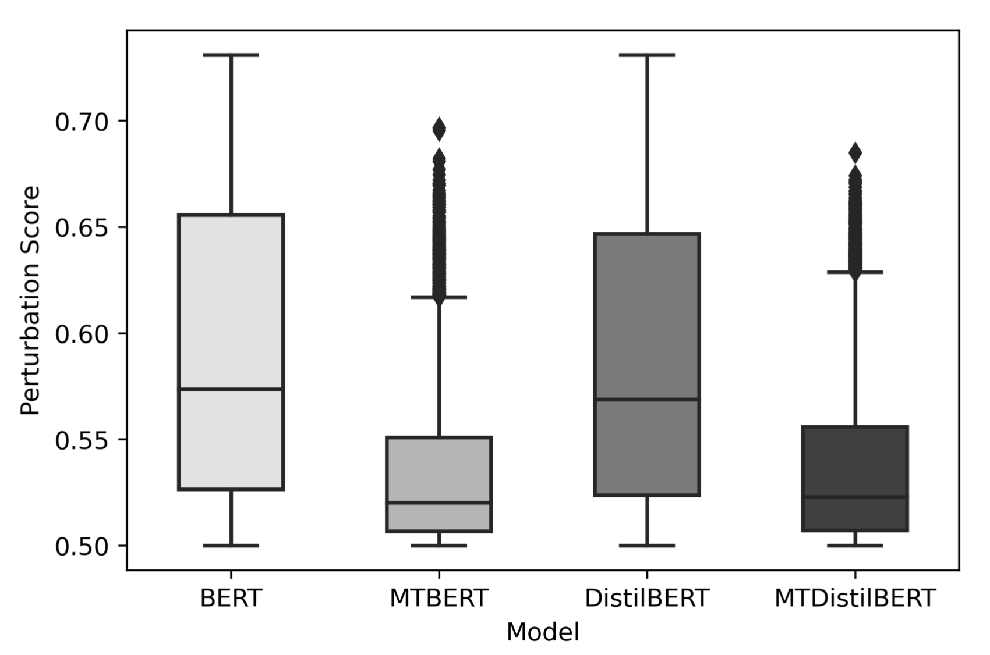
Perturbation score
MTBERT model has managed attacks confidence score in the leaner interquartile range and does not cross 0.70 which is a significant improvement over BERT.
The range of the MTBERT model is 0.50 to 0.55, but for the BERT model, it is 0.50 to 0.66.
Model fine-tuned using proposed approach is comparatively significant leaner than model fine-tuned using conventional approach.
Box plot of perturbation score considering both dataset

Slide 29
Discussing Research question
Experiment result supports hypothesis
Data augmentation
- Including noisy data increase robustness if suitable loss is introduced in the training called consistency regularization [1,2].
- Proposd approach exploit consistency regularization.
Exponential Moving Average
- Ensemble technique can lead to a stronger predictor.
- Averaging weights over time also provides a more accurate model than using final weights directly [3].
- Teacher model performed better since it was an average of consecutive student models.
References
Erik Englesson and Hossein Azizpour. “Consistency Regularization Can Improve Robustness to Label Noise”. In: arXiv:2110.01242 [cs, stat] arXiv: 2110.01242 [cs, stat].
Yonatan Belinkov and Yonatan Bisk. “Synthetic and Natural Noise Both Break Neural Machine Translation”. In: arXiv:1711.02173 [cs] (Feb. 2018). arXiv: 1711.02173 [cs].
Antti Tarvainen and Harri Valpola. “Mean Teachers Are Better Role Models: Weight- averaged Consistency Targets Improve Semi-Supervised Deep Learning Results”.
Notes:
Language models fine-tuned with the proposed approach has shown a improvement over conventional method of fine-tuning in terms of robustness without compromising original accuracy.

Slide 30
Conclusion
Language model are sensitive to adversarial attacks.
Improves generalization and robustness
More resilient towards attacks
Examined language model capabilities
Consistency Regularization and Exponential Moving Average
Opportunity to gain understanding
Notes:
Language models are sensitive to adversarial attacks.
Proposed approach of fine-tuning improved original accuracy by 0∼2% and accuracy under attack by 20∼30%.
The mean teacher technique is more resilient to attacks and does not allow attack recipes to sabotage models with high confidence.
Examined the eﬀicacy of data augmentation techniques that utilizes the capabilities of language models.
Research studies was conducted in an attempt to investigate the cause of the observed behaviour.
Consistency regularization and Exponential Moving Average (EMA) weight assignments were found to be the most prevalent explanations for the observed behaviour.
The opportunity to advance the understanding of language models, data augmentation, and various adversarial attacks in the text-domain.

Slide 31
Limitations
Hard to achieve Image level Imperceptibility
Space and Time complexity
No common assessment criteria
No single defence to prevent from all
Implementation challenge
Notes:
Image level imperceptibility is still a challenge in text domain, due to its discrete nature.
Comparatively more space and time-consuming than the conventional approach.
No common assessment criteria or frameworks for evaluating the robustness.
Still this mechanism doesn’t prove to be resilient to all kind of attacks.
Attacks, data augmentation techniques, and semi-supervised training methodologies established in the image domain cannot be applied directly to the text domain.

Slide 32
Future Work
Extreme pre-training hurts robustness
Quantitative analysis of individual augmentation techniques
Reducing computational complexity
Comparing performance of Virtual adversarial and Mean teacher approach
Interpretability
Building Verification framework
Notes:
Hypothesis: Extreme pre-training of language models can hurt model robustness.
Quantitatively measuring the effectiveness of individual augmentation techniques on robustness can be studied.
Working towards reducing computational complexity.
Comparing gradient-based adversarial training and the proposed fine-tuning approach.
Building a common robustness verification framework that can be used to compare various methodologies.
Interpretability using adversarial attacks.

Slide 33
Refernces
Christian Szegedy et al. “Intriguing Properties of Neural Networks”. (Feb. 2014).
Wenqi Wang et al. “Towards a Robust Deep Neural Network in Texts: A Survey”. In: arXiv:1902.07285 [cs] (Apr. 2021). arXiv: 1902.07285 [cs]
Di Jin et al. “Is BERT Really Robust? A Strong Baseline for Natural Language Attack on Text Classification and Entailment”. In: Proceedings of the AAAI Conference on Artificial Intelligence 34.05 (Apr. 2020), pp. 8018–8025. issn: 2374-3468. doi: 10.1609/aaai. v34i05.6311.
Nicolas Papernot et al. “Crafting Adversarial Input Sequences for Recurrent Neural Net- works”. In: arXiv:1604.08275 [cs] (Apr. 2016). arXiv: 1604.08275 [cs].
Antti Tarvainen and Harri Valpola. “Mean Teachers Are Better Role Models: Weight- averaged Consistency Targets Improve Semi-Supervised Deep Learning Results”. In: arXiv:1703.01780 [cs, stat] (Apr. 2018). arXiv: 1703.01780 [cs, stat].
Jinfeng Li et al. “TextBugger: Generating Adversarial Text Against Real-world Applications”. In: Proceedings 2019 Network and Distributed System Security Symposium (2019). doi: 10.14722/ndss.2019.23138. arXiv: 1812.05271.
Siddhant Garg and Goutham Ramakrishnan. “BAE: BERT-based Adversarial Examples for Text Classification”. In: arXiv:2004.01970 [cs] (Oct. 2020). arXiv: 2004.01970 [cs].
Shuhuai Ren et al. “Generating Natural Language Adversarial Examples through Prob- ability Weighted Word Saliency”. In: Proceedings of the 57th Annual Meeting of the Association for Computational Linguistics. Florence, Italy: Association for Computational Linguistics, July 2019, pp. 1085–1097. doi: 10.18653/v1/P19-1103.
George A. Miller. “WordNet: A Lexical Database for English”. In: Communications of the ACM 38.11 (Nov. 1995), pp. 39–41. issn: 0001-0782. doi: 10.1145/219717.219748.
Jacob Devlin et al. “BERT: Pre-training of Deep Bidirectional Transformers for Language Understanding”. In: arXiv:1810.04805 [cs] (May 2019). arXiv: 1810.04805 [cs].
Victor Sanh et al. “DistilBERT, a Distilled Version of BERT: Smaller, Faster, Cheaper and Lighter”. In: arXiv:1910.01108 [cs] (Feb. 2020). arXiv: 1910.01108 [cs].
John X. Morris et al. “TextAttack: A Framework for Adversarial Attacks, Data Augmentation, and Adversarial Training in NLP”.
Parth Patwa et al. “Fighting an Infodemic: COVID-19 Fake News Dataset”. In: arXiv:2011.03327 [cs] (Mar. 2021). arXiv: 2011.03327 [cs]
Andrew L. Maas et al. “Learning Word Vectors for Sentiment Analysis”. In: Proceedings of he 49th Annual Meeting of the Association for Computational Linguistics: Human Language Technologies. Portland, Oregon, USA: Association for Computational Linguistics, June 2011.
Yonatan Belinkov and Yonatan Bisk. “Synthetic and Natural Noise Both Break Neural Machine Translation”. In: arXiv:1711.02173 [cs] (Feb. 2018). arXiv: 1711.02173 [cs].
Erik Englesson and Hossein Azizpour. “Consistency Regularization Can Improve Robust- ness to Label Noise”. In: arXiv:2110.01242 [cs, stat] (Oct. 2021). arXiv: 2110.01242 [cs, stat].

Slide 34
Questions

Slide 35
Thank you

